Slide 1
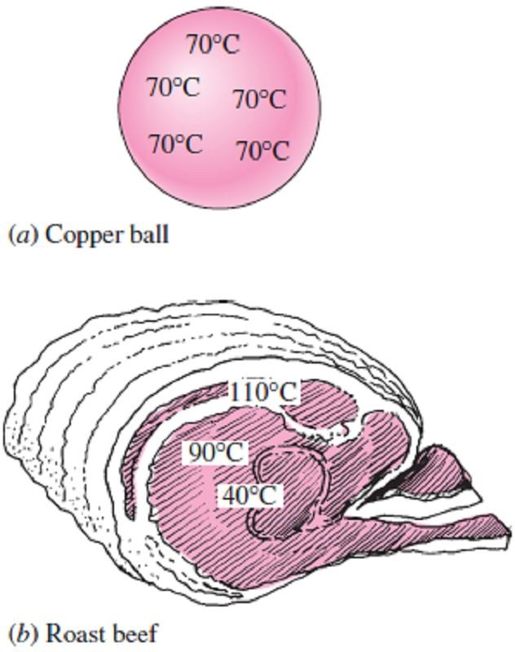
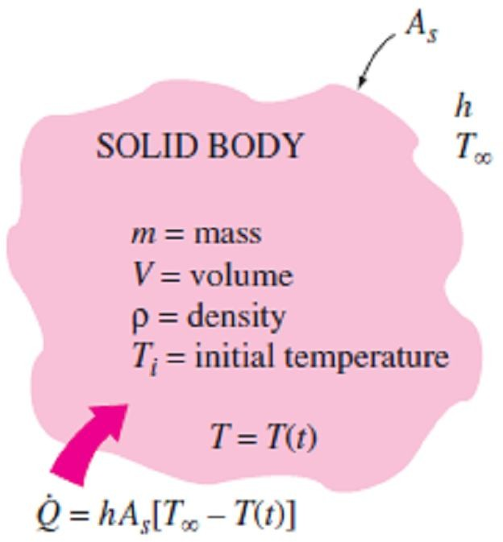
Chapter Four Transient Heat Conduction
4.1- Introduction
The temperature of a body, in general, varies with time as well as position. In rectangular coordinates, this variation is expressed as T(x, y, z, t), where (x, y, z) indicates variation in the x, y, and z directions, respectively, while t indicates variation with time.
4.2- Lumped System Analysis
In heat transfer analysis, some bodies are observed to behave like a “lump” whose interior temperature remains essentially uniform at all times during a heat transfer process. The temperature of such bodies can be taken to be a function of time only, T(t). Heat transfer analysis that utilizes this idealization is known as lumped system analysis.
Consider a small hot copper ball coming out of an oven as in
Fig.(4.1.a). Measurements indicate that the temperature of the copper ball changes with time, but it does not change much with position at any given time. Thus, the temperature of the ball remains uniform at all
times, and we can talk about the temperature of the ball with no
Fig.(4.1) A small copper ball can be modeled as a lumped system, but a roast beef cannot
reference to a specific location. Now let consider a large roast in an
oven as in Fig.(4.1.a). We must have noticed that the temperature
distribution within the roast is not even close to being uniform since the outer parts of the roast are well done while the center part is barely warm. Thus, lumped system analysis is not applicable in this case.
To develop the formulation associated with lumped system, Consider a body of arbitrary shape of mass m, volume V, surface area A_{s}, density ρ, and specific heat C_{p} initially at a uniform temperature T_{i} as in Fig.(4.2). At time t = 0, the body is placed into a medium at temperature T∞ of a heat transfer coefficient h. Assuming that T∞>T_{i}, but the analysis is equally valid for the opposite case. We assume lumped system analysis to be applicable, so that the temperature changes with time only, T = T(t). During a differential time interval dt, the temperature of the body rises by a differential amount dT. An
energy balance of the solid for the time interval dt can be expressed as;
Fig.(4.2) The geometry and parameters involved in the lumped system analysis
⎛ Heat transfer into ⎞ ⎛The increase in the energy ⎞
⎜ ⎟ = ⎜
the body during dt of the body during dt
⎟
⎠
⎝ ⎠ ⎝
or;
h A_{s} (T∞ −T ) dt = mC_{p} dT ☹(4.1)
Noting that m = ρV and dT = d(T - T∞) since T∞ = constant, Eq.(4.1) can be rearranged as;
d (T − T∞ ) ₌ ₋ h A_{s}
V C_{p}
dt ☹(4.2)
T − T∞
Integrating from t = 0, at which T = T_{i}, to any time t, at which T = T(t), gives;
ln
⎡T (t) − T ⎤
= −
h A_{s}
❒ V C
t ☹(4.3)
⎢ _{T}
T
∞
⎥
⎣ i ∞ ⎦
p
Or by taking the exponential of both sides and rearranging, we obtain;
T (t ) − T∞ T_{i} − T∞
_{= e} −b t
☹ (4.4.a)

Slide 2
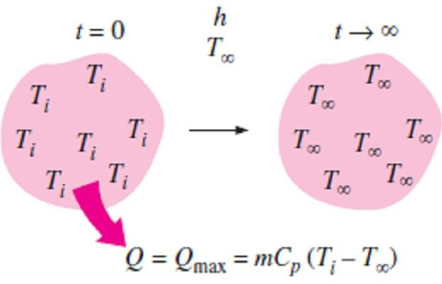
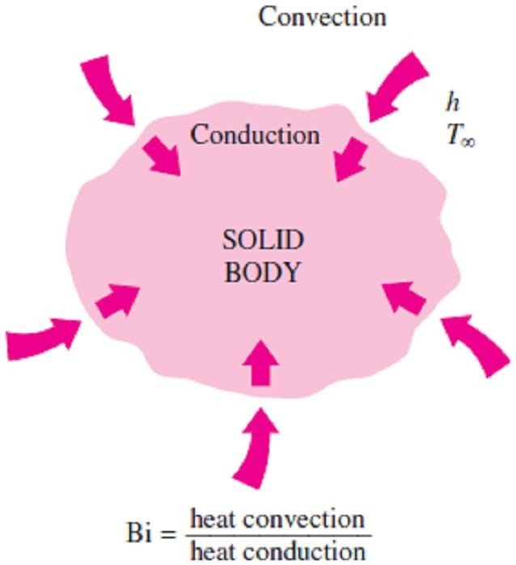
Chapter Four
Transient Heat Conduction
where; b = ^{h As} (1 / sec) ☹ (4.4.b)  V C _{p} is a positive quantity whose dimension is (time)⁻¹. The reciprocal of b has time unit (usually sec), and is called the time constant. Note1- Once the temperature T(t) at time t is available from Eq.(4.4.a), the rate of convection heat transfer between the body and its environment at that time can be determined from Newton’s law of cooling as; Q (t ) = h A_{s} [T (t ) − T∞ ] (W ) ☹(4.5) Note2- The total amount of heat transfer between the body and the surrounding medium over the time interval t = 0 to t is simply the change in the energy content of the body as follow; Q =  V C _{p} [T (t ) − T_{i} ] (kJ ) ☹ (4.6.a) Note3- The amount of heat transfer reaches its upper limit when the body reaches the surrounding temperature T∞ where the time approaches to t ∞. Therefore as shown in Fig.(4.3), the maximum heat transfer between the body and its surroundings is; Q_{max} =  V C _{p} [T∞ − T_{i} ] (kJ ) ☹ (4.6.b) 4.2.1- Criteria for Lumped System Analysis The first step in establishing a criterion for the applicability of the lumped system analysis is to define a characteristic length as; L = ^{V} (m) ☹ (4.7.a) c _{A} s and a Biot number Bi as; Bi = ^{h Lc} (m) ☹ (4.7.b) k where it can also be expressed as in Fig.(4.4), as follow; _{Bi =} h ΔT ₌ Convection at the surface of the body (k / L_{c} ) ΔT Conduction within the body or; _{Bi =} (L_{c} / k ) ₌ Conduction resistance within the body |  | Fig.(4.3) Heat transfer to or from a body reaches its maximum value when the body reaches the environment temperature Fig.(4.4) The Biot number can be viewed as the ratio of the convection at the surface to conduction within the body
(1/ h) | Convection resistance at the surface of the body
Note1- The Biot number is the ratio of the internal resistance of a body to heat conduction to its external resistance to heat convection. Therefore, a small Biot number represents small resistance to heat conduction, and thus small temperature gradients within the body. Note2- Lumped system analysis assumes a uniform temperature distribution throughout the body, which will be the case only when the thermal resistance of the body to heat conduction (the conduction resistance) is zero. Thus, lumped system analysis is exact when Bi = 0 and approximate when Bi > 0. Note3- It is generally accepted that the lumped system analysis is applicable if (Bi ≤ 0.1). Note4- The Biot number is the ratio of the convection at the surface to conduction within the body, and this number should be as small as possible for lumped system analysis to be applicable. Therefore, small bodies with high thermal conductivity are good candidates for lumped system analysis, especially when they are in a medium that is a poor conductor of heat (such as air or another gas) and motionless. Thus, the hot small copper ball placed in quiescent air, discussed earlier, is most likely to satisfy the criterion for lumped system analysis as shown in Fig.(4.5).

Slide 3
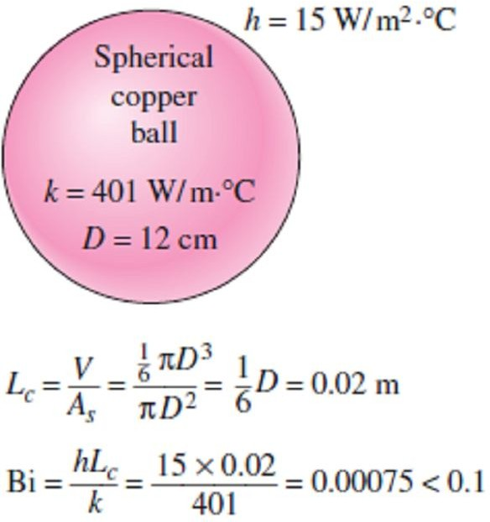
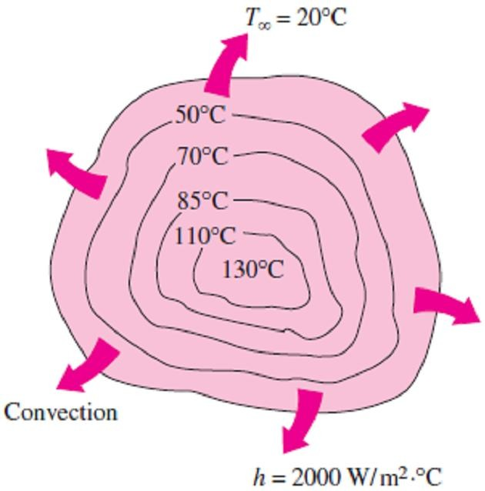
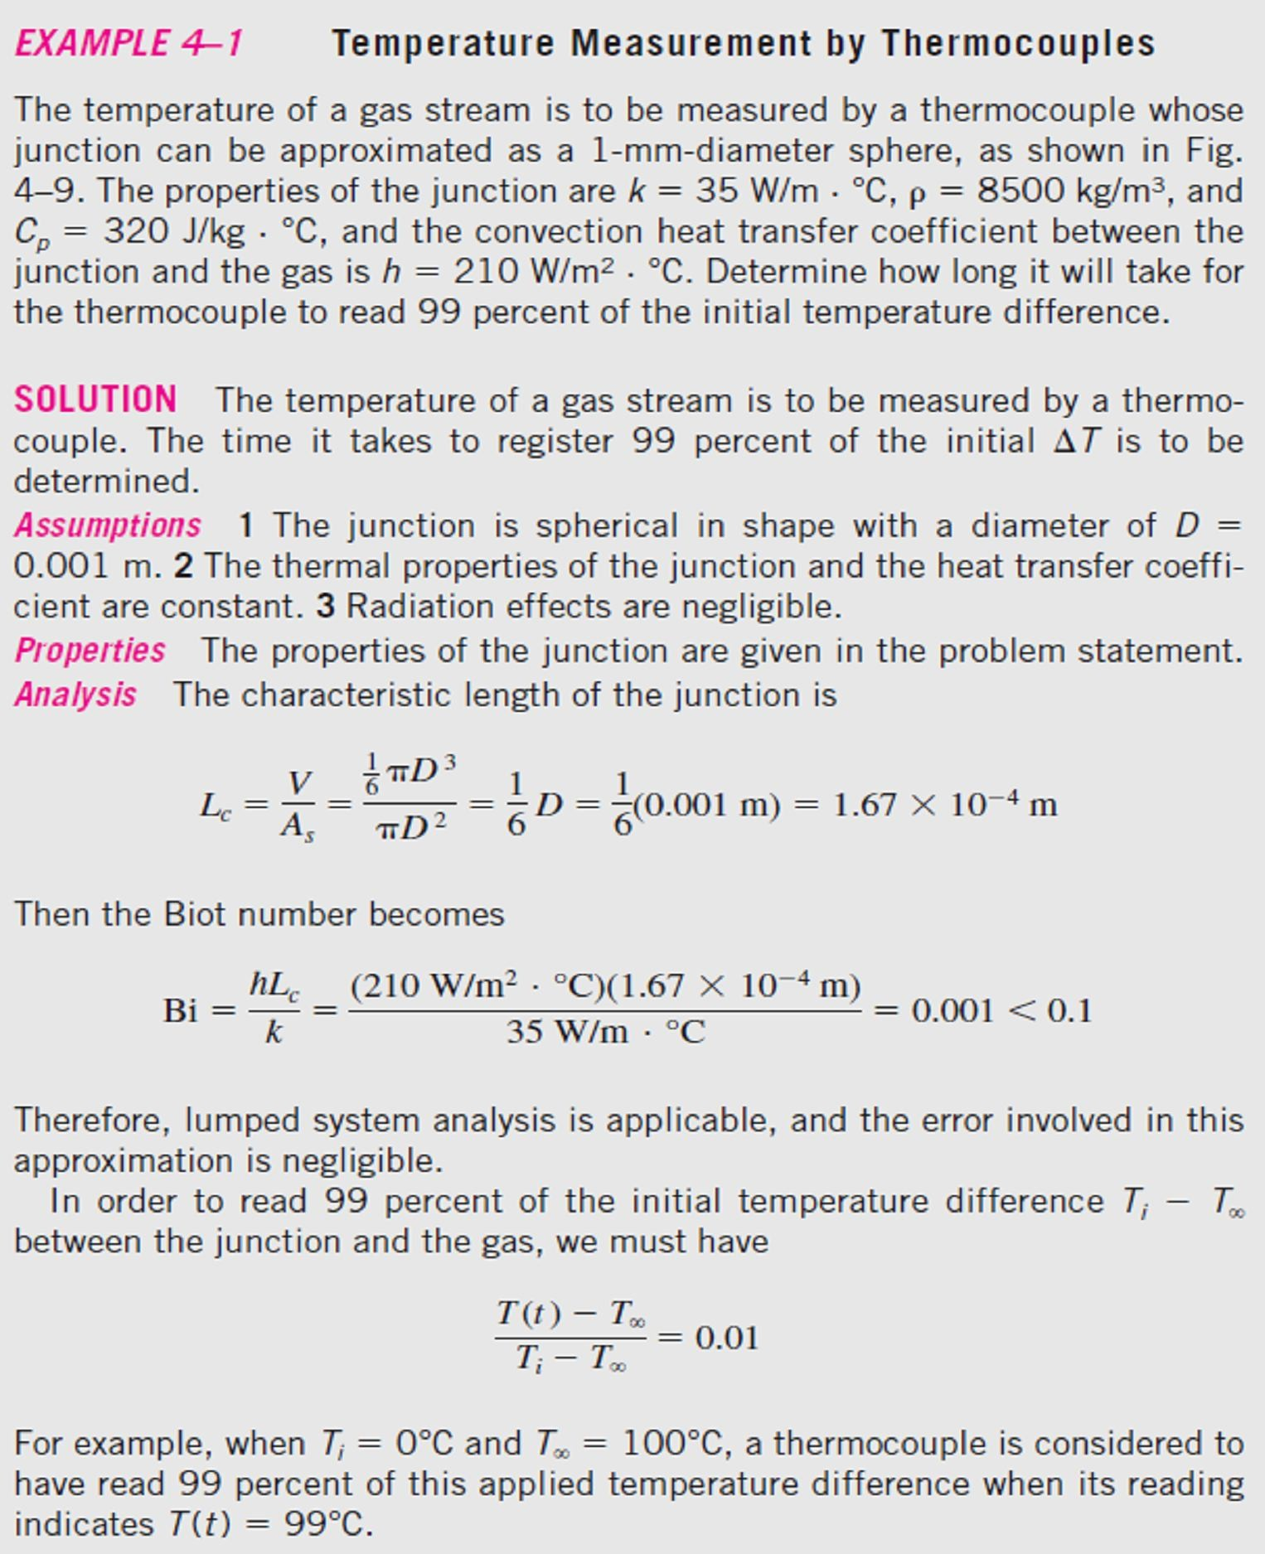
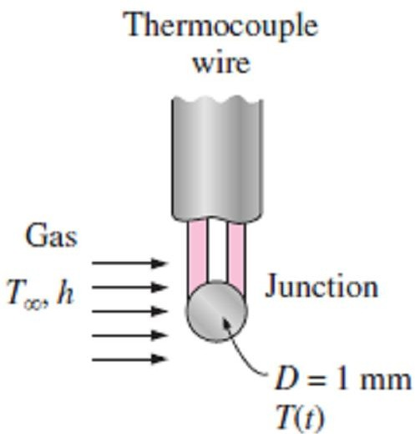
Chapter Four Transient Heat Conduction
Note5- When the convection heat transfer coefficient h and thus convection heat transfer from the
body are high, the temperature of the body near the surface will drop quickly as in Fig.(4.6). This will create a larger temperature difference between the inner and outer regions unless the body is able to transfer heat from the inner to the outer regions just as fast.
Fig.(4.5) Small bodies with high thermal conductivities and low convection coefficients are most likely to satisfy the criterion for lumped system analysis
Fig.(4.6) When the convection coefficient h is high and k is low, large temperature differences occur between the inner
and outer regions of a large solid
(4.7).
Fig.(4.7) Schematic for Example- 4.1

Slide 4
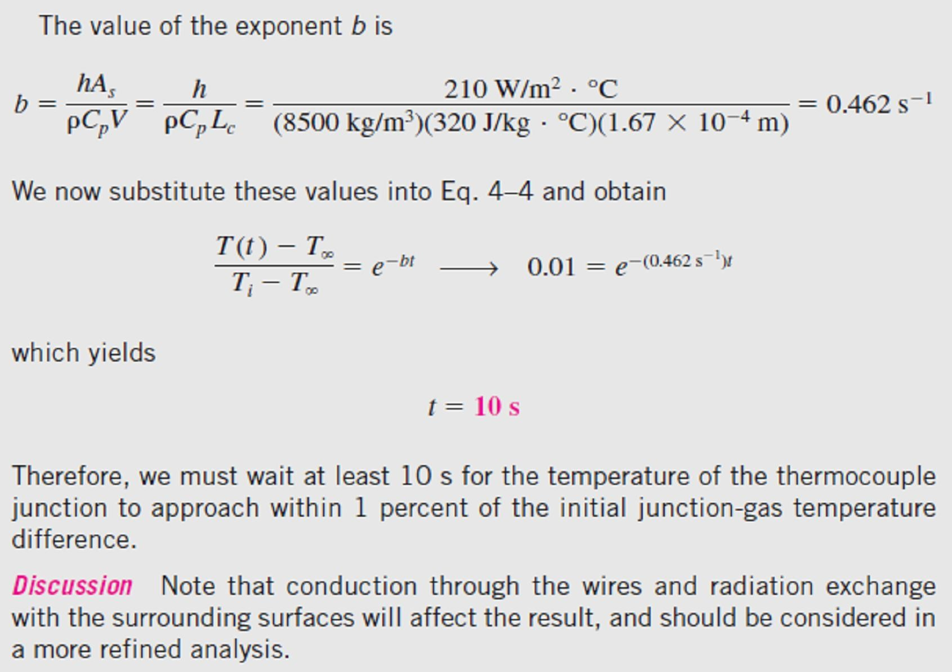
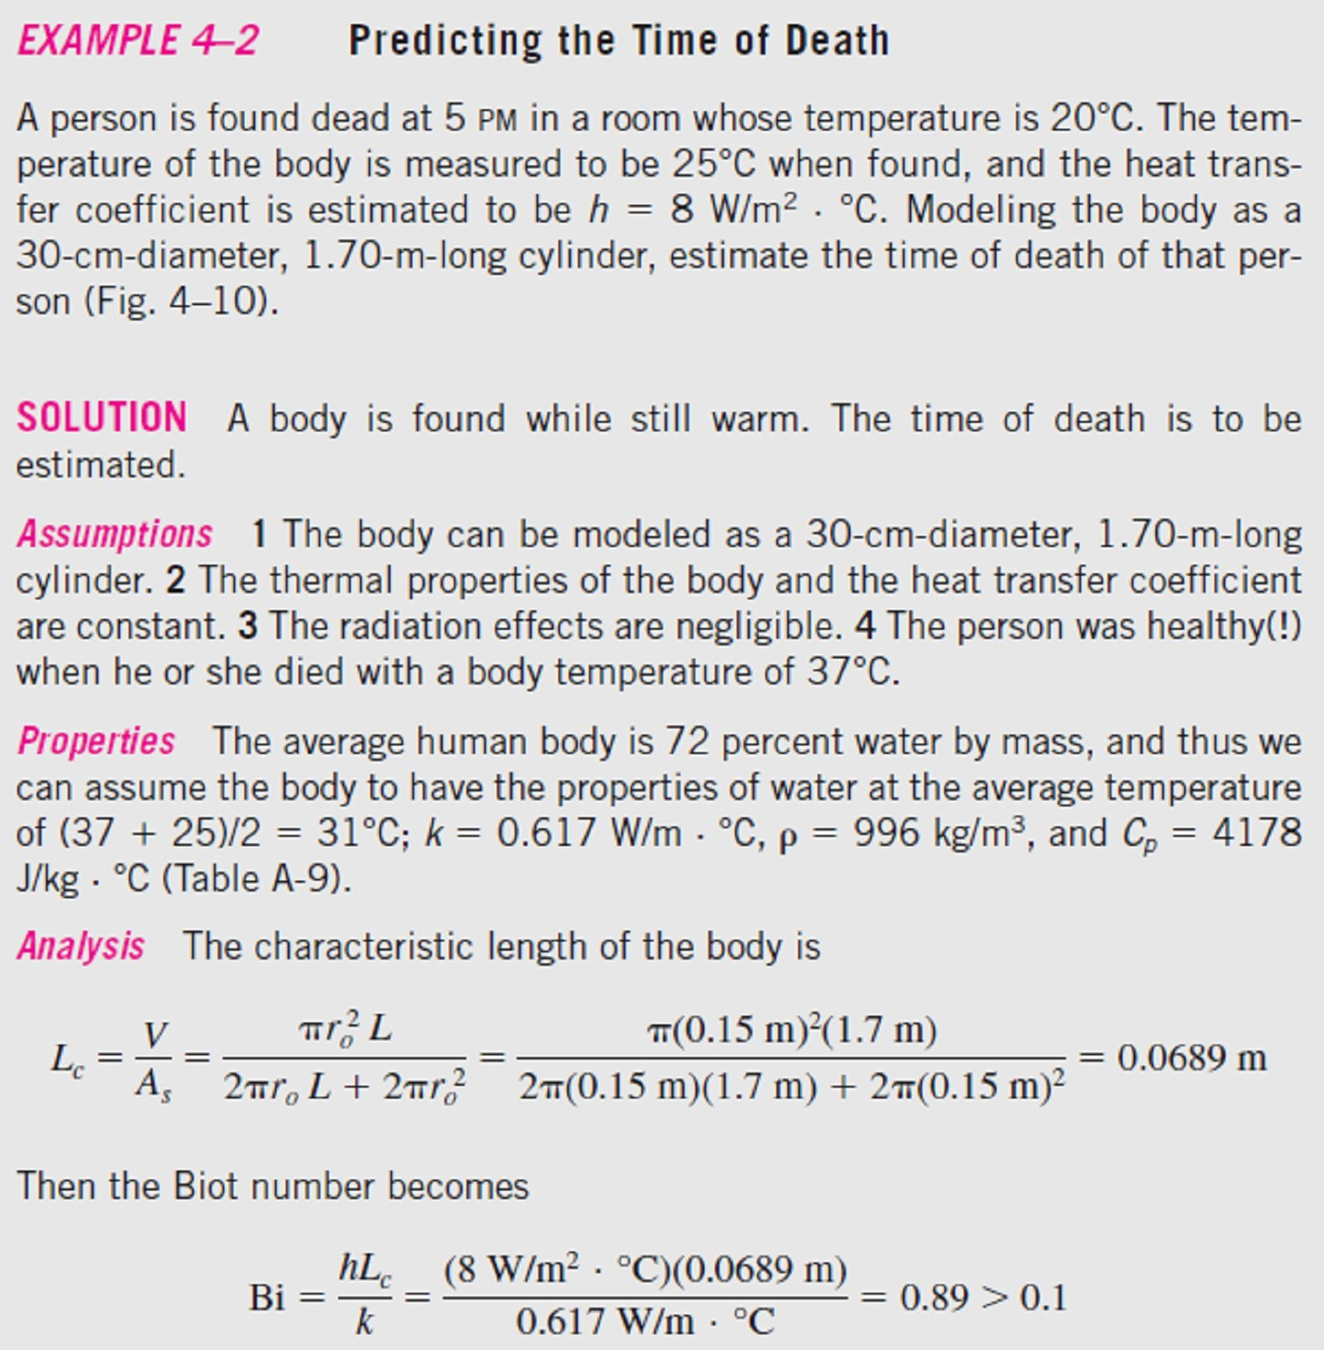

Chapter Four
Transient Heat Conduction
3.1-
as in Fig.(4.8).
Fig.(4.8)
Schematic for Example- 4.2

Slide 5
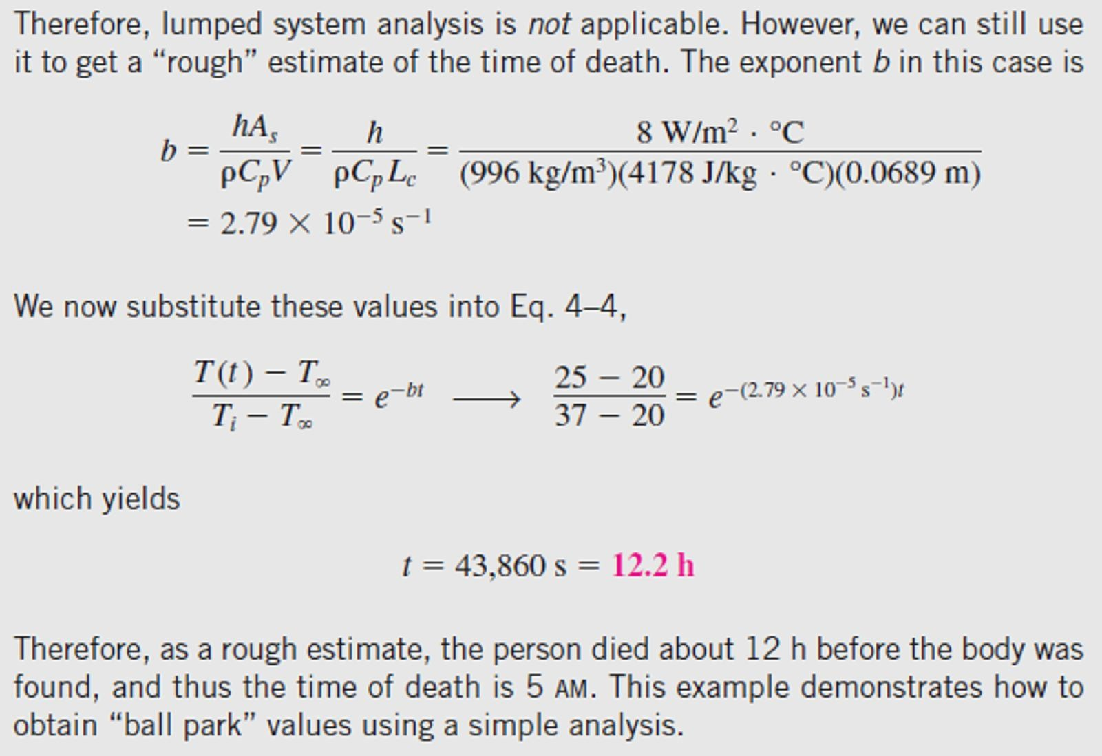
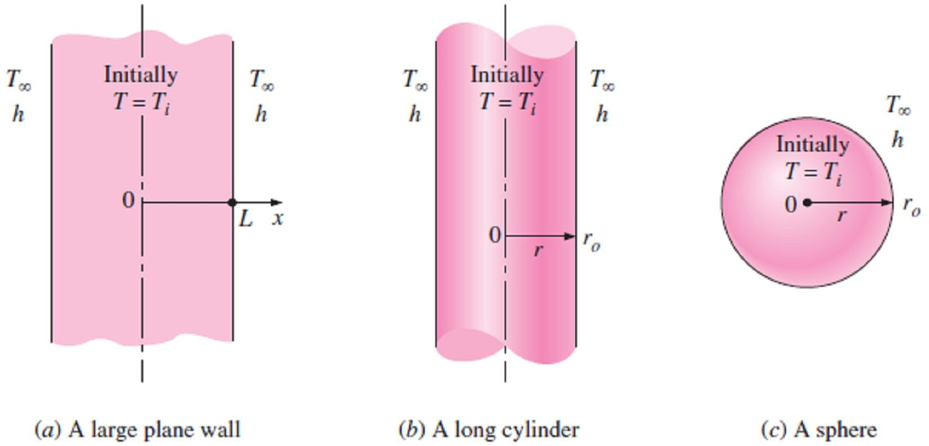
Chapter Four
Transient Heat Conduction
4.3- Transient Heat Conduction in Large Plane Walls, Long Cylinders, and Spheres with Spatial Effects
In general, however, the temperature within a body will change from point to point as well as with
time. In this section, we consider the variation of temperature with time and position in one- dimensional problems such as those associated with a large plane wall, a long cylinder, and a sphere.
Consider a plane wall of thickness 2L, a long cylinder of radius r_{o}, and a sphere of radius r_{o} initially at a uniform temperature T_{i}, as shown in Fig.(4.9). At time t = 0, each geometry is placed in a large
medium that is at a constant temperature T∞ and kept in that medium for t > 0.
Heat transfer takes place between these bodies and their environments by convection with a uniform and constant heat transfer coefficient h. Note that all three cases possess geometric and thermal symmetry: the plane wall is symmetric about its center plane (x = 0), the cylinder is symmetric about its centerline (r = 0), and the sphere is symmetric about its center point (r = 0).
Note1- In the present formulation, we will neglect radiation heat transfer between these bodies and their surrounding surfaces, or incorporate the radiation effect into the convection heat transfer coefficient h.
Fig.(4.9) Schematic of the simple geometries in which heat transfer is one-dimensional

Slide 6
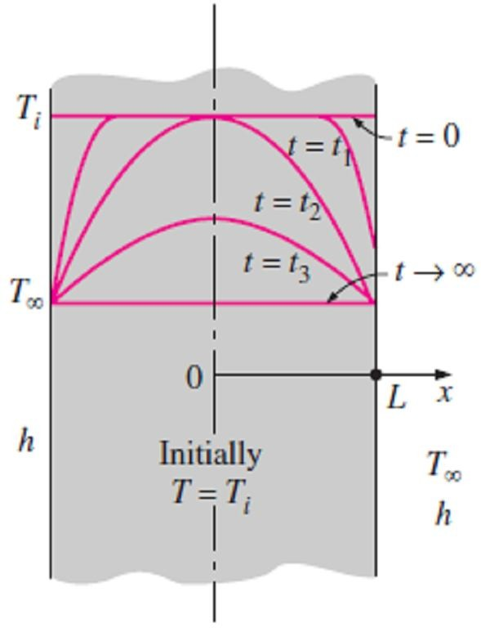
Chapter Four Transient Heat Conduction
Note2- The variation of the temperature profile with time in the plane wall is illustrated in Fig.(4.10), where we'll note the below points;
When the wall is first exposed to the surrounding medium at T∞< T_{i}
at t = 0, the entire wall is at its initial temperature T_{i}. But the wall temperature at and near the surfaces starts to drop as a result of heat transfer from the wall to the surrounding medium. This creates a temperature gradient in the wall and initiates heat conduction from the inner parts of the wall toward its outer surfaces.
The temperature at the center of the wall remains at T_{i} until t = t₂,
where the temperature profile within the wall remains symmetric at all times about the center plane.
The temperature profile gets flatter and flatter as time passes as a
result of heat transfer, and eventually becomes uniform at T = T∞, where the wall reaches thermal equilibrium with its surroundings.
Fig.(4.10) Transient temperature
At that point, the heat transfer stops since there is no longer a profiles in a plane wall exposed to
temperature difference.
convection for T_{i}>T∞
Note3- The formulation of the problems for the determination of the one-dimensional transient temperature distribution T(x, t) in a wall results in a partial differential equation, which can be solved using advanced mathematical techniques. The solution, however, can be presented in tabular or graphical form, where, that solution involves the parameters x, L, t, k, α, h, T_{i}, and T∞, which are too many to make any graphical presentation of the practical results. So, in order to reduce the number of parameters, we'll nondimensionalize the problem by defining the following dimensionless quantities;
Dimensionless temperature :
_{ (x,t) =} T(x,t) - T∞
⎫
⎪
⎪
⎪
⎪
⎬
⎪
⎪
T - T
i ∞
Dimensionless distance from the center : X = ^{x}
L
😐(4.8)
Dimensionless heat transfer coefficient : Bi = ^{h L} ☹(Biot number)
k
 t
2
⎪
Dimensionless time :  =
😐(Fourier number)⎪
L
⎪⎭
Note4- The dimensionless quantities defined above for a plane wall can also be used for a cylinder or
sphere by replacing the space variable x by r and the half-thickness L by the outer radius r_{o}.
Note5- The characteristic length in the definition of the Biot number is taken to be the half-thickness L
for the plane wall, and the radius r_{o} for the long cylinder and sphere.
4.3.1- Infinite series solution of one-dimensional transient heat conduction problems
The one-dimensional transient heat conduction problem just described can be solved exactly for any of the three geometries, but the solution involves infinite series, which are difficult to deal with. However, the terms in the solutions converge rapidly with increasing time, and for τ > 0.2, keeping the first term and neglecting all the remaining terms in the series results in an error under 2%, and thus it
is very convenient to express the solution using this one-term approximation, given as;
⎫
T(x, t) - T
− ² 
Plane wall :  ( x, t) = ∞ = A e cos( x / L),  > 0.2⎪
wall 1
1
1
T - T
⎪
⎪
⎬
⎪
i ∞
T(r, t) - T
− ² 
Cylinder :  (r, t) = ∞ = A e J ( r / r ),  > 0.2
😐(4.9)
cyl 1
1
0 1 o
T - T
i ∞
sin(₁r / r_{o} )
⎪
⧫ > 0.2 ⎪
⎪⎭
T(r, t) - T
1 ,
Sphere :  (r, t) = ∞ = A e
− ² 
sph 1
● r / r
T - T
i ∞
1 o
where the constants A₁ and λ₁ are functions of the Bi number only.

Slide 7
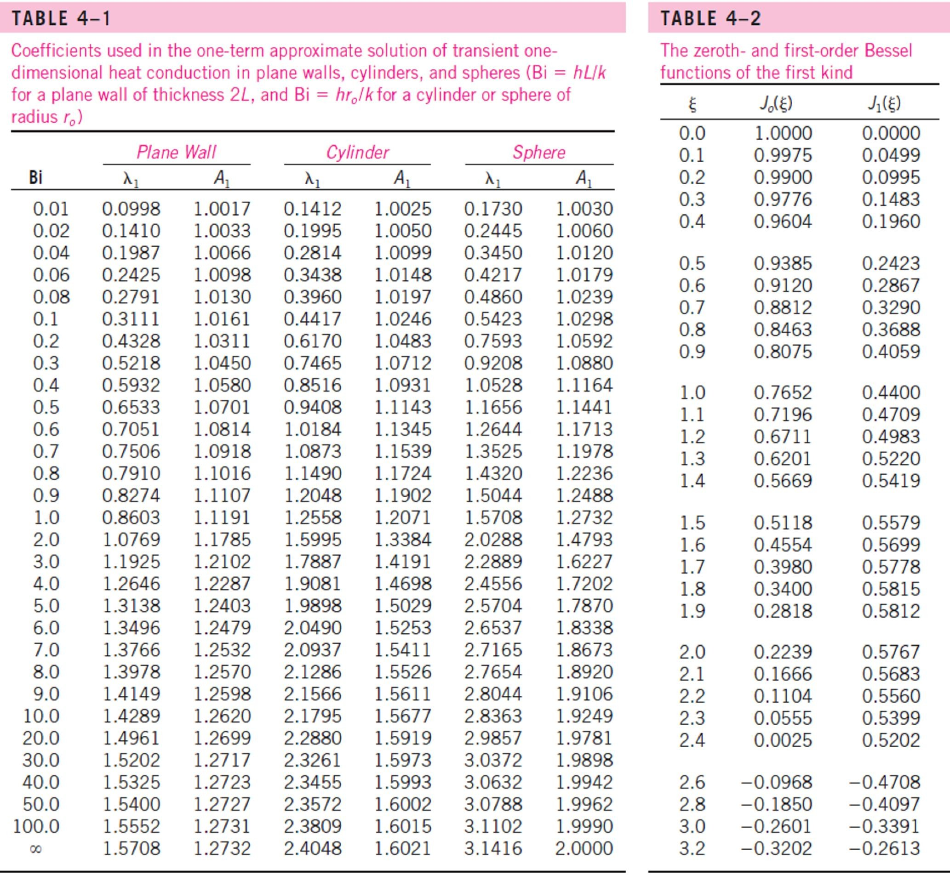
Chapter Four Transient Heat Conduction
4.3.1.1- Tables method for solution of one-dimensional transient heat conduction problems
The values of constants A₁ and λ₁ are listed in Table(4.1) against the Bi number for all three geometries. Also the function J₀ is the zeroth-order Bessel function of the first kind, whose value can be determined from Table(4.2).
Note1- If the Bi number is known, the above relations can be used to determine the temperature anywhere in the medium. The determination of the constants A₁ and λ₁ usually requires interpolation.
Note2- We know that cos(0) = J₀(0) = 1 and the limit of (sin x)/x is also equals to 1, so, the previous
relations can be simplified to the next ones at the center of a plane wall, cylinder, or sphere as follow;
T(0, t) - T
2
⎫
⎪
⎪
⎪
⎬
Center of plane wall (x = 0) :  (0, t) =
∞
= A e
− 
wall
T - T
1
1
i ∞
T(0, t) - T
2
1
Center of cylinder (r = 0) :  (0, t) =
∞
= A e
− 
😐 (4.10)
cyl
T - T
1
⎪
i ∞
2 ⎪
Center of sphere (r = 0) :  (0, t) =
T(0, t) - T
∞
= A e
− 
⎪
⎭
sph
T - T
1
1
i ∞

Slide 8
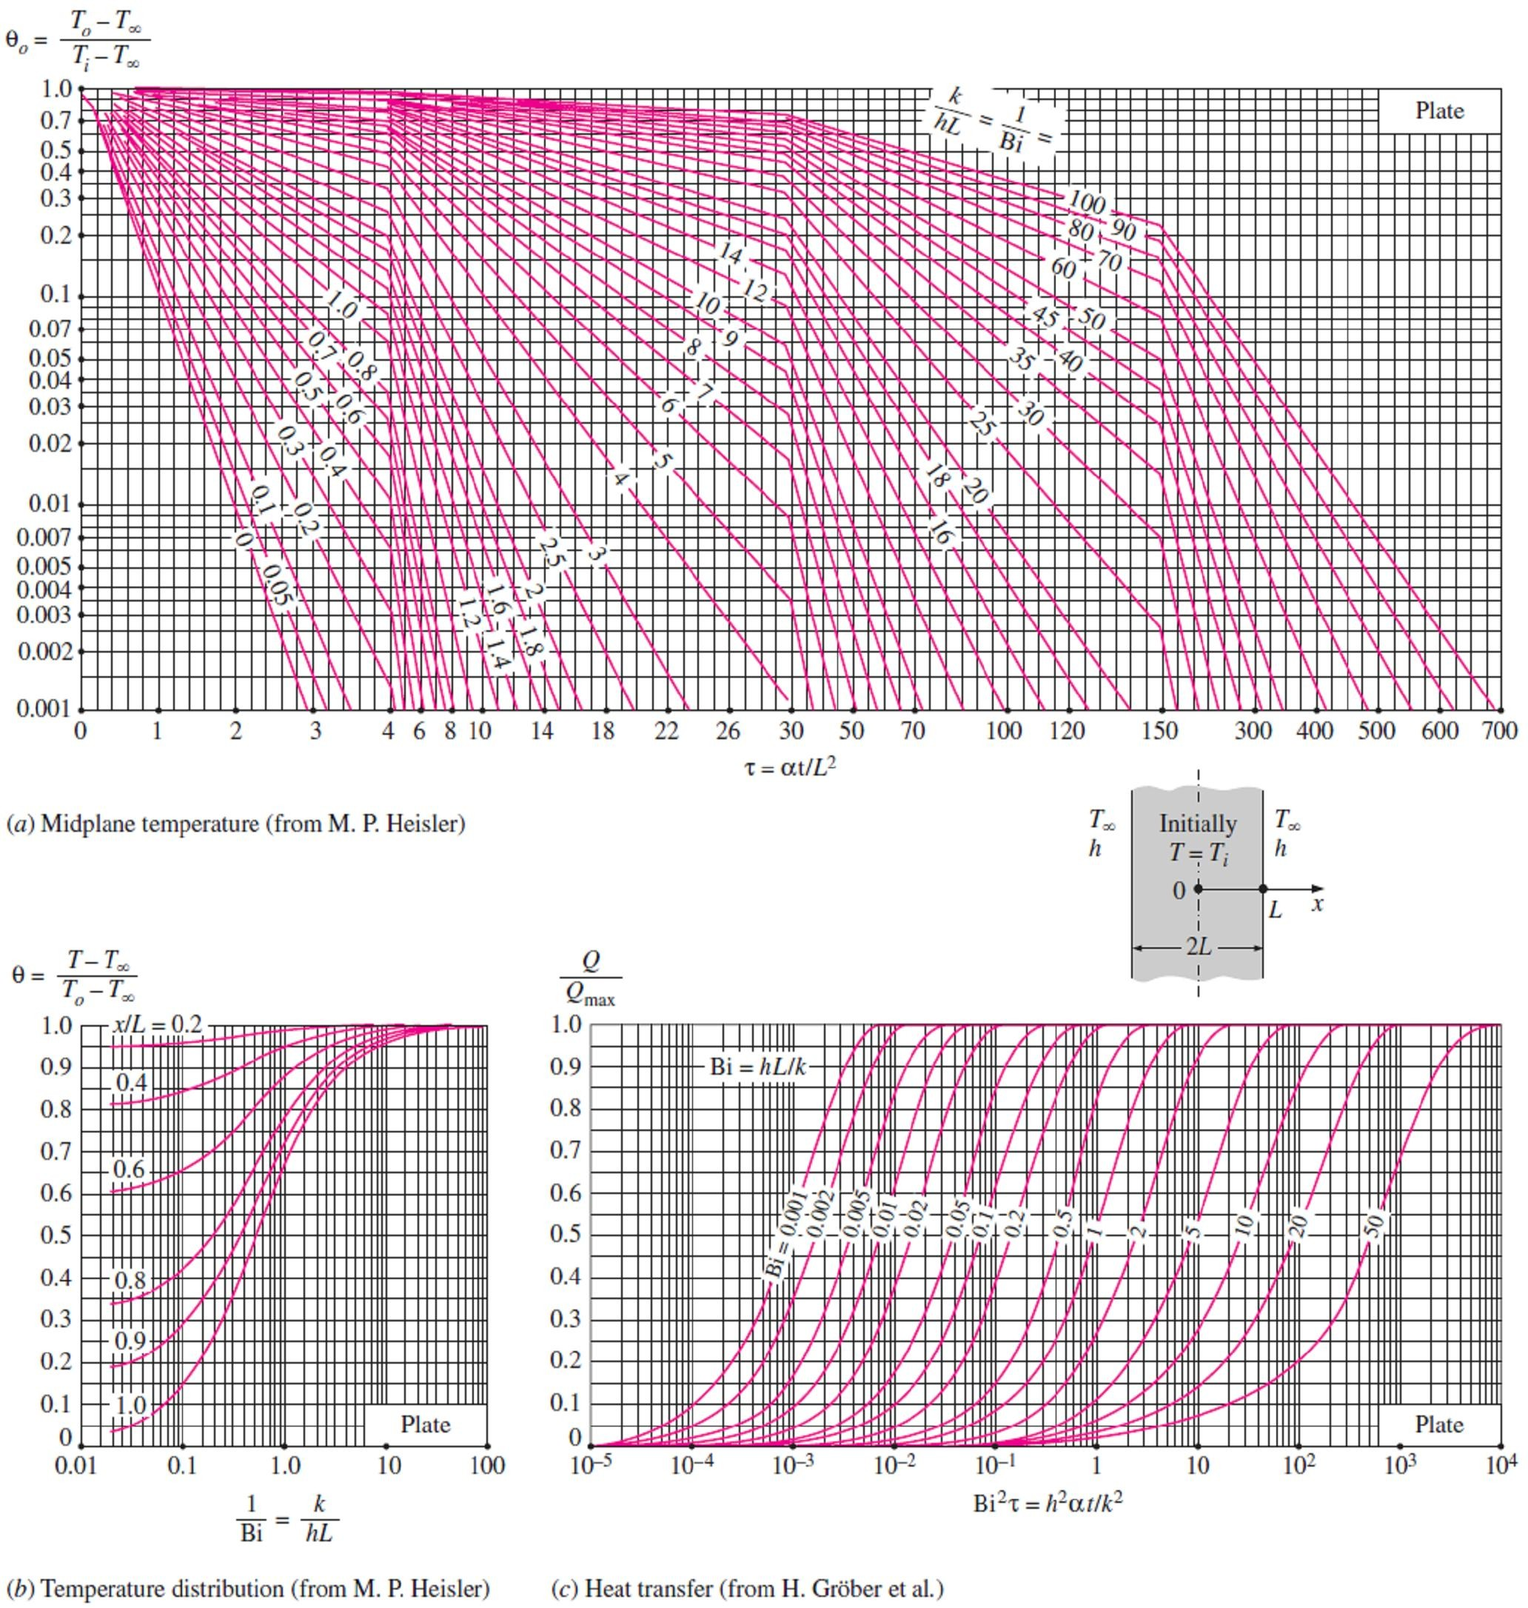
Chapter Four Transient Heat Conduction
4.3.1.2- Charts method for solution of one-dimensional transient heat conduction problems
For those who prefer reading charts to interpolating, the previous relations are plotted and the one- term approximation solutions are presented in graphical form, known as the transient temperature charts.
Note1- The charts are sometimes difficult to read, and they are subject to reading errors, therefore, the relations above should be preferred to the charts.
Note2- The transient temperature charts in Figs.[(4.11), (4.12), and (4.13)] for a large plane wall, long cylinder, and sphere were presented by M. P. Heisler in 1947 and are called Heisler charts.
Note3- There are three charts associated with each geometry: the first chart is to determine the temperature T_{o} at the center of the geometry at a given time t. The second chart is to determine the
temperature at other locations at the same time in terms of T_{o}. The third chart is to determine the total
amount of heat transfer up to the time t. All these plots are valid for τ > 0.2.
Fig.(4.11) Transient temperature and heat transfer charts for a plane wall of thickness 2L initially at a uniform temperature T_{i} subjected to convection from both sides to an environment at temperature T∞ with a convection coefficient of h

Slide 9
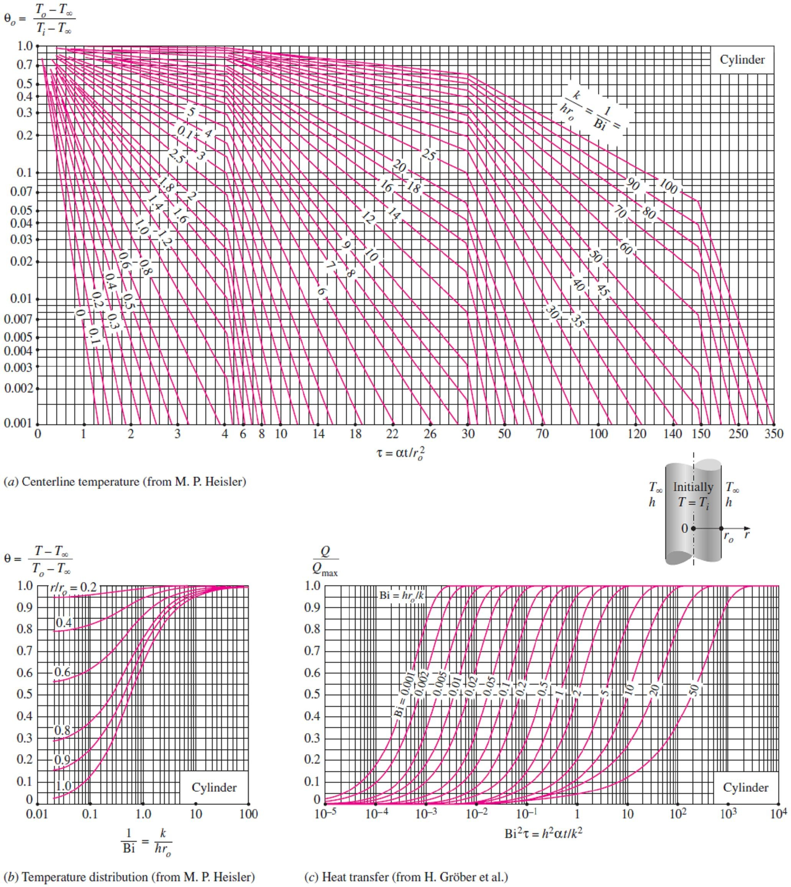
Chapter Four
Transient Heat Conduction
Fig.(4.12) Transient temperature and heat transfer charts for a long cylinder of radius r_{o} initially at a uniform temperature T_{i} subjected to convection from all sides to an environment at temperature T∞ with a convection coefficient of h

Slide 10
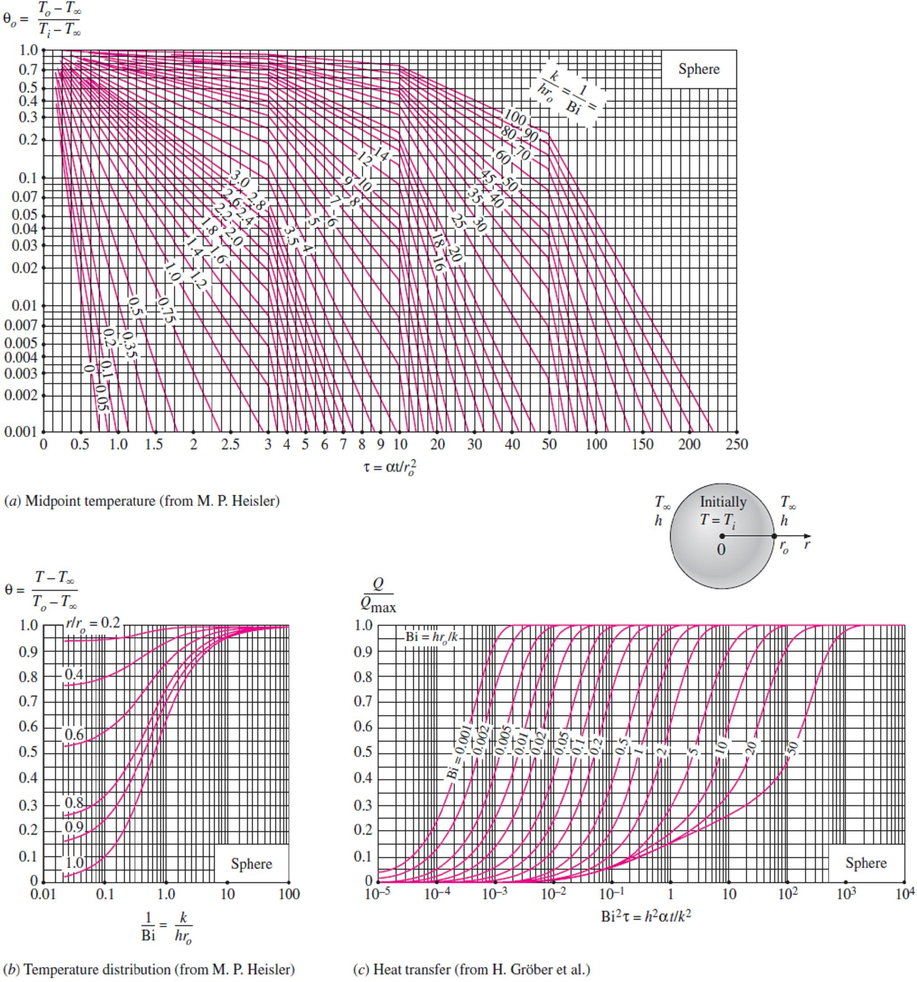
Chapter Four
Transient Heat Conduction
Fig.(4.13) Transient temperature and heat transfer charts for a sphere of radius r_{o} initially at a uniform temperature T_{i} subjected to convection from all sides to an environment at temperature T∞ with a convection coefficient of h
Note4- The case of 1/Bi = k /hL = 0 corresponds to h → ∞, which corresponds to the case of specified
surface temperature T∞. That is, the case in which the surfaces of the body are suddenly brought to the temperature T∞ at t = 0 and kept at T∞ at all times can be handled by setting h to infinity as shown in Fig.(4.14).
Note5- The temperature of the body changes from the initial temperature T_{i} to the temperature of the surroundings T∞ at the end of the transient heat conduction process. Thus, the maximum amount of heat that a body can gain (or lose if Ti > T∞) is simply the change in the energy content of the body. That is;
Q_{max} = mC_{p} (T∞ −T_{i} ) = V C_{p} (T∞ −T_{i} ) (kJ) ☹(4.11)
where m is the mass, V is the volume, ρ is the density, and C_{p} is the specific heat of the body.

Slide 11
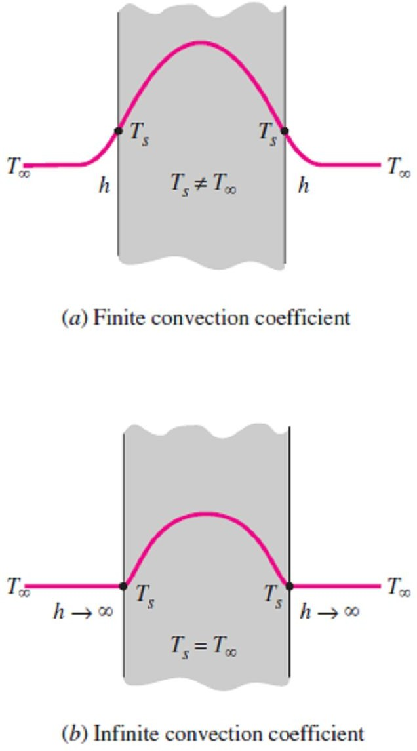
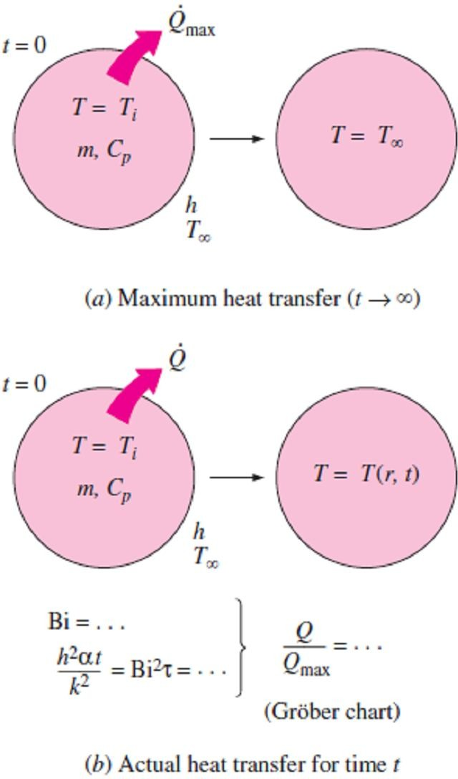
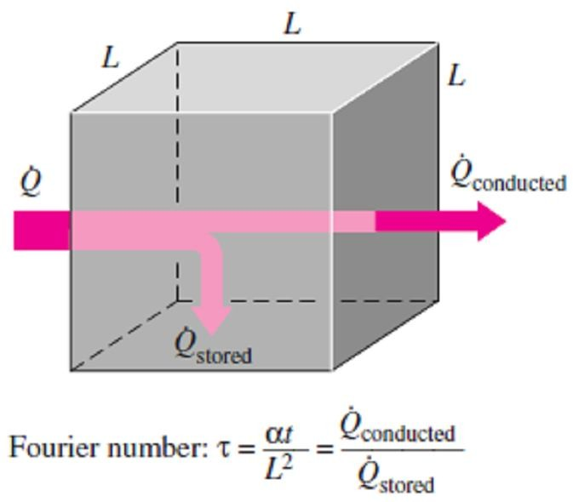
Chapter Four Transient Heat Conduction
Note6- Q_{max} represents the amount of heat transfer for t → ∞, so, the amount of heat transfer Q at a finite time t will obviously be less than this maximum. The ratio Q/Q_{max} is plotted in Figs.[(4.11.c), (4.12.c), and (4.13.c)] against the variables Bi and (h²α t /k²) for the large plane wall, long cylinder, and sphere, respectively, where from the fraction of heat transfer Q/Q_{max} which can be determined from these charts for the given t, the actual amount of heat transfer by that time can be evaluated by multiplying this fraction by Q_{max}. A negative sign for Q_{max} indicates that heat is leaving the body as shown in Fig.(4.15).
Note7- The fraction of heat transfer Q/Q_{max} can also be determined from the below relations, which are based on the one-term approximations as follow;
⎛ Q ⎞
sin 
⎫
⎪
⎪
⎪
Plane wall : ⎜ ⎟
^{= 1 − } 0, wall ¹
⎝ ^{Q}max ⎠ _{wall}
₁
⎛ Q ⎞
J ( )
⎪
Cylinder :
⎜ ⎟
= 1 − 2
0, cyl
1 1
⎬
😐 (4.11)
Q
●
⎝ max ⎠_{cyl}
1
⎪
⎛ Q ⎞
sin  −  cos  ⎪
Sphere : ⎜ ⎟ = 1 − 3
1 1 1 ⎪
⎜ _{Q} ⎟
0, sph
3
⎪
⎝ max ⎠ _{sph}
1
⎭
Note8- To understand the physical significance of the Fourier number τ, we express it as in Fig.(4.16) to be;
⎛The rate at which heat is conducted ⎞
⎜ ⎟
 t k L² (1/ L) ΔT
⎜ across (L) of a body of volume(L³ ) ⎟
⧫ = =
₌ ⎝ ⎠
☹(4.12)
_{L}2
❒ C L³ / t ΔT
⎛The rate at which heat is stored ⎞
p
⎜
⎟
⎜
in a body of volume(L³ )
⎟
⎝ ⎠
Thus, a large value of the Fourier number indicates faster transmission of heat through a body.
Fig.(4.14) The specified surface temperature corresponds to the case of convection to an environment at T∞ with a convection coefficient h
Fig.(4.15) The fraction of total heat transfer Q/Q_{max} up to a specified time t is determined using the Gröber charts
Fig.(4.16) Fourier number at time t can be viewed as the ratio of the rate of heat conducted to the rate of heat stored

Slide 12
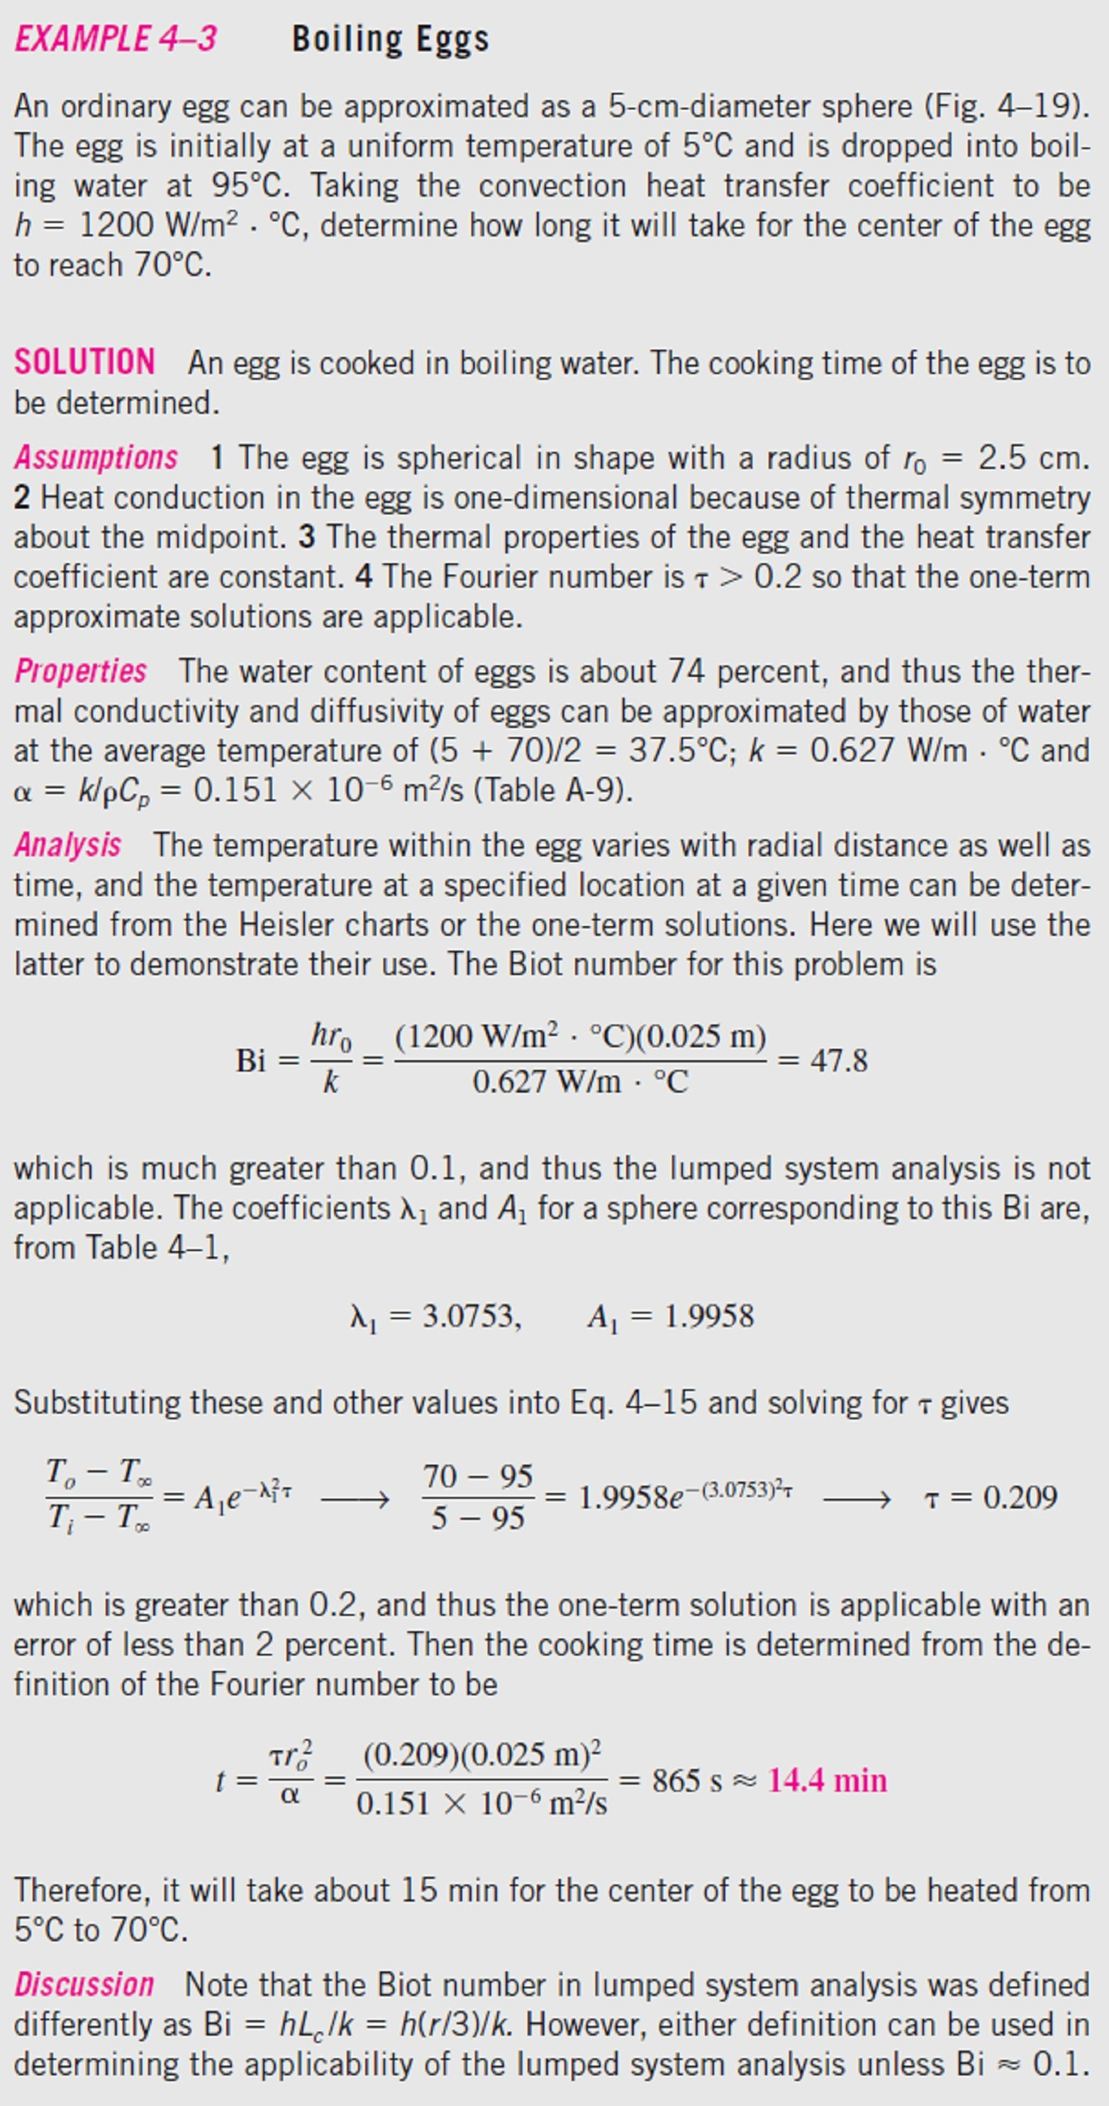
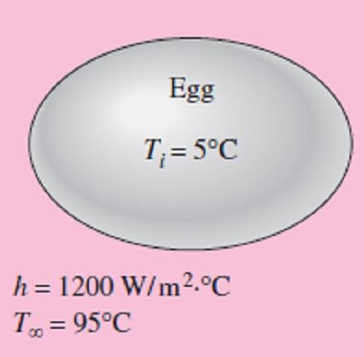
Chapter Four
Transient Heat Conduction

Slide 13
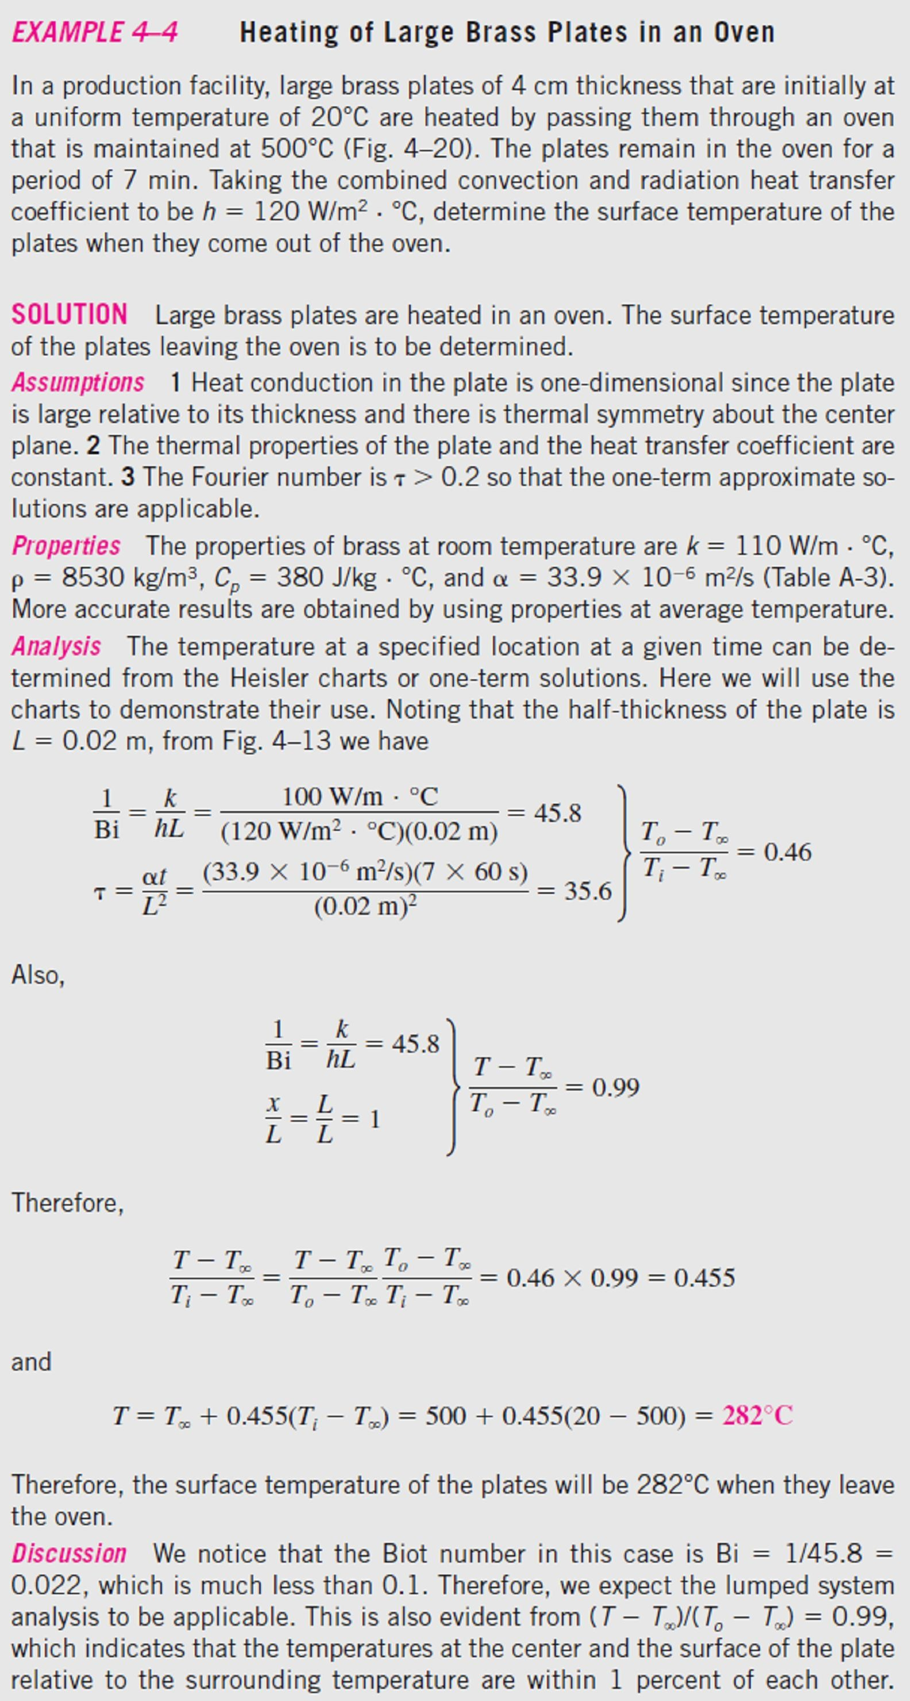
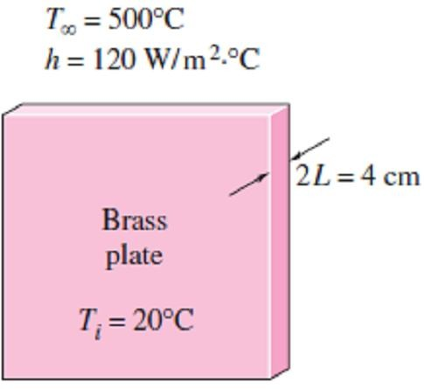
Chapter Four
Transient Heat Conduction

Slide 14
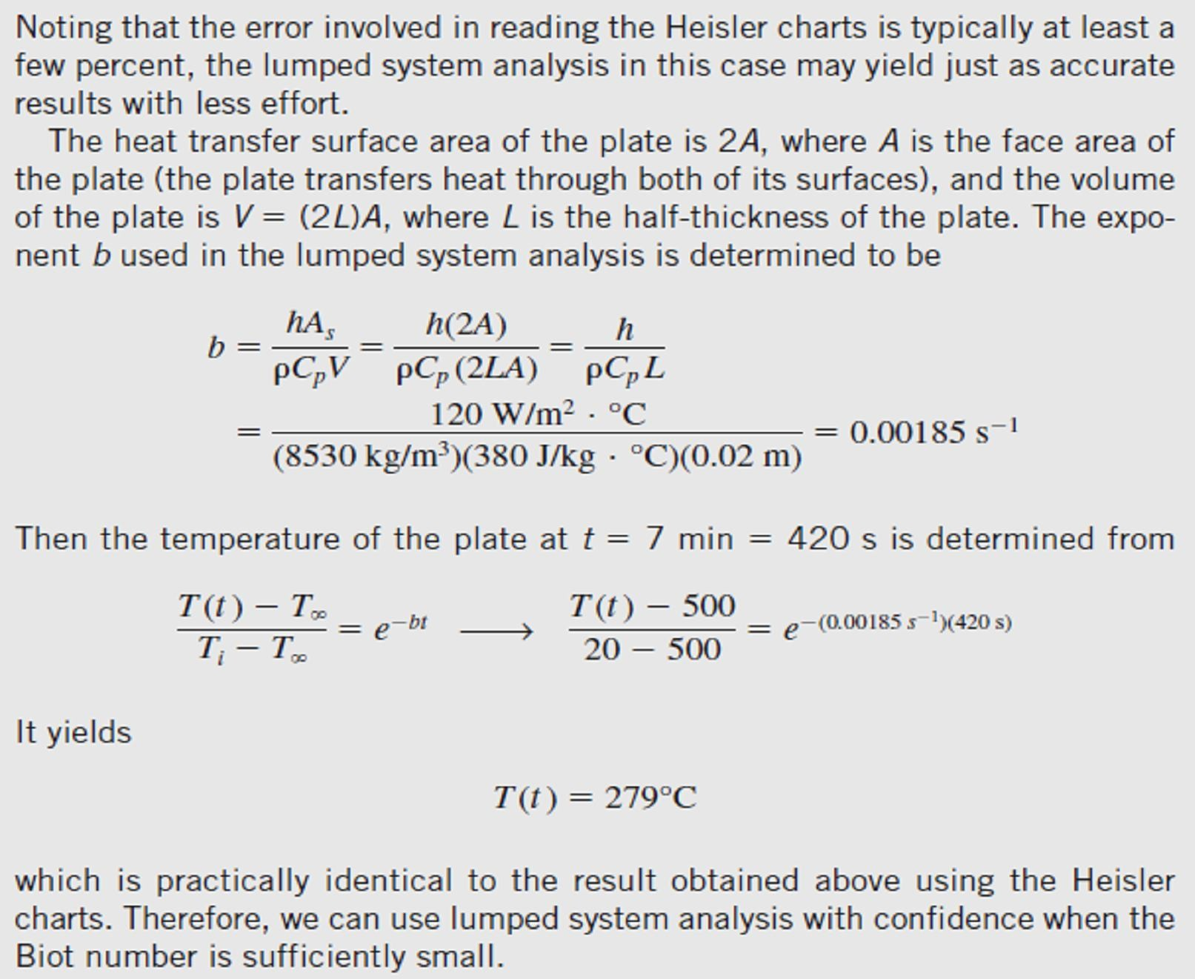
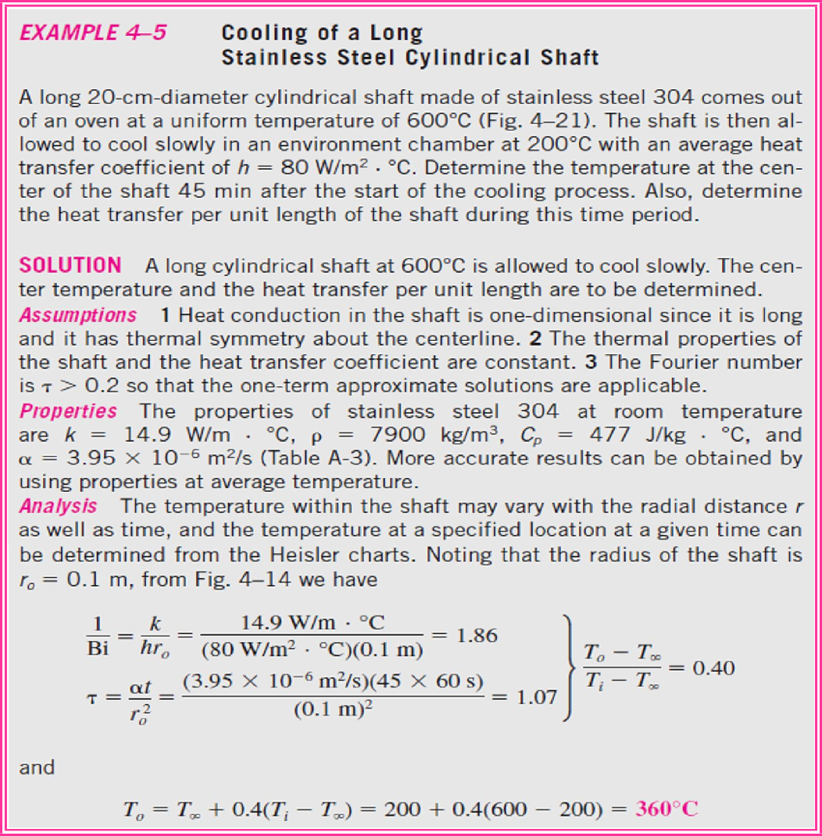
Chapter Four
Transient Heat Conduction

Slide 15
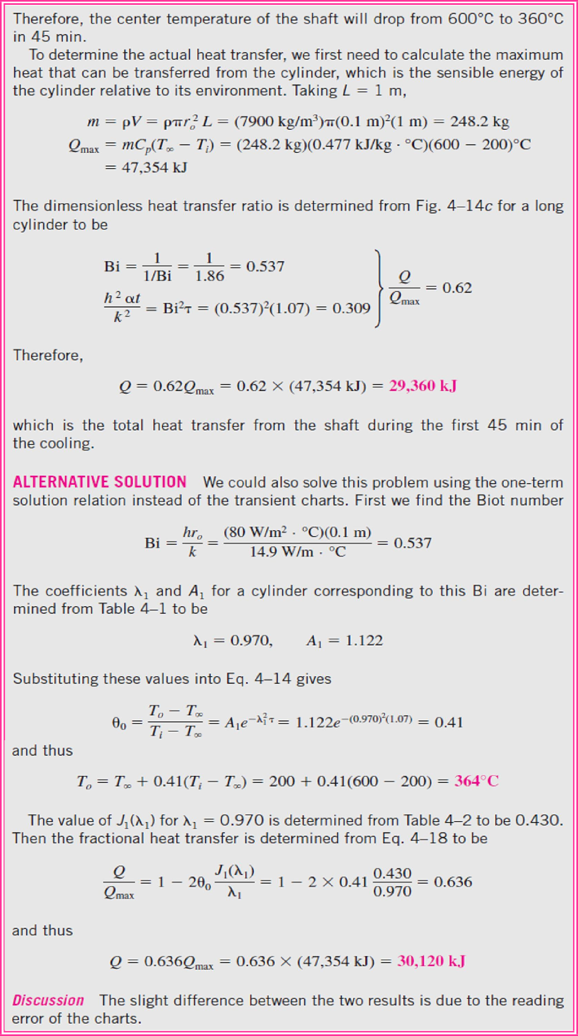
Chapter Four
Transient Heat Conduction

Slide 16

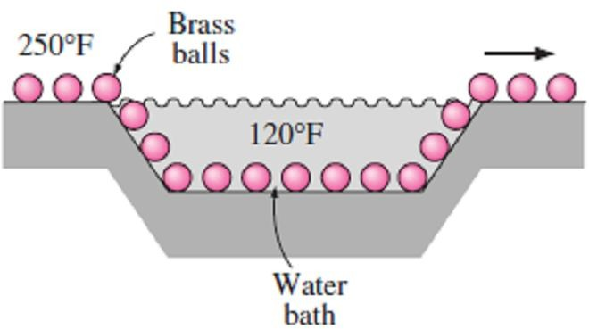
Chapter Four
Transient Heat Conduction
PROBLEMS
4.1- The temperature of a gas stream is to be measured by a thermocouple whose junction can be approximated as a 1.2mm-diameter sphere. The properties of the junction are k = 35 W/m·C°, ρ = 8500 kg/m³, and C_{p} =320 J/kg·C°, and the heat transfer coefficient between the junction and the gas is h = 65 W/m²·C°. Determine how long it will take for the thermocouple to read 99 percent of the initial temperature difference.
Answer: 38.5 sec 4.2- In a manufacturing facility, 2in-diameter brass balls (k = 64.1 Btu/h ·ft·F°, ρ = 532 lbm/ft³, and Cp = 0.092 Btu/lbm·F°) initially at 250F° are cooled in a water bath at 120F° for a period of 2min at a rate of 120 balls per minute. If the convection heat transfer coefficient is 42 Btu/h· ft²·F°, determine (a) the temperature of the balls after cooling and (b) the rate at which heat needs to be removed from the water in order to keep its temperature constant at 120F°.
Answers: 166F°, 1196 Btu/min
Btu/lbm · F ), and the heat transfer coefficient between the iced water and the aluminum can is 30 Btu/h · ft²·F°. Using the properties of water for the drink, estimate how long it will take for the canned drink to cool to 45F°.
Answer: 406 sec
Prob.(4.4)
4.5- Consider a 1000W iron whose base plate is made of 0.5cm-thick aluminum alloy (ρ = 2770 kg/m³, Cp = 875 J/kg·C°, α = 7.3×10⁻⁵ m²/s). The base plate has a surface area of 0.03m². Initially, the iron is in thermal equilibrium with the ambient air at 22C°. Taking the heat transfer coefficient at the surface of the base plate to be 12 W/m²·C° and assuming 85 percent of the heat generated in the resistance wires is transferred to the plate, determine how long it will take for the plate temperature to reach 140C°. Is it realistic to assume the plate temperature to be uniform at all times? Answer: 51.8 sec
4.6- Stainless steel ball bearings (ρ= 8085kg/m³, k = 15.1 W/m·C°, and C_{p} = 0.480 kJ/kg·C°) having a diameter of 1.2cm are to be cooled in water. The balls leave the oven at a uniform temperature of 900C° and are exposed to air at 30C° for a while before they are dropped into the water. If the temperature of the balls is not to fall below 850C° prior to quenching and the heat transfer coefficient in the air is 125 W/m²·C°, determine how long they can stand in the air before being dropped into the water.
Answer: 3.7 sec
Prob.(4.2)
4.3- To warm up some milk for a baby, a mother pours milk into a thin-walled glass whose diameter is 6cm. The height of the milk in the glass is 7cm. She then places the glass into a large pan filled with hot water at 60C°. The milk is stirred constantly, so that its temperature is uniform at all times. If the heat transfer coefficient between the water and the glass is 120 W/m²·C°, determine how long it will take for the milk to warm up from 3C° to 38C°. Take the properties of the milk to be (k = 0.607 W/m · C,
❒ = 998 kg/m³, and C_{p} = 4.182 kJ/kg · C ). Can the milk in this case be treated as a lumped system? Why? Answer: 5.8 min
4.4- In order to cool a cola drink in a can of temperature 80F°, which is 5in high and has a diameter of 2.5in, a person takes the can and starts shaking it in the iced water of the chest at 32F°. The temperature of the drink can be assumed to be uniform at all times, the properties the drink are (  = 62.22 lbm/ft³, and C_{p} = 0.999
4.7- Carbon steel balls (ρ = 7833 kg/m³, k = 54 W/m·C°, C_{p} =0.465 kJ/kg·C°, and α =1.474×10⁻⁶ m²/s) 8mm in diameter are annealed by heating them first to 900C° in a furnace and then allowing them to cool slowly to 100C° in ambient air at 35C°. If the average heat transfer coefficient is 75 W/m²·C°, determine how long the annealing process will take. If 2500 balls are to be annealed per hour, determine the total rate of heat transfer from the balls to the ambient air.
Answers: 163 sec, 543 W

Slide 17
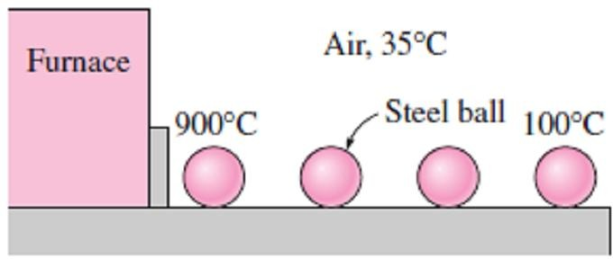
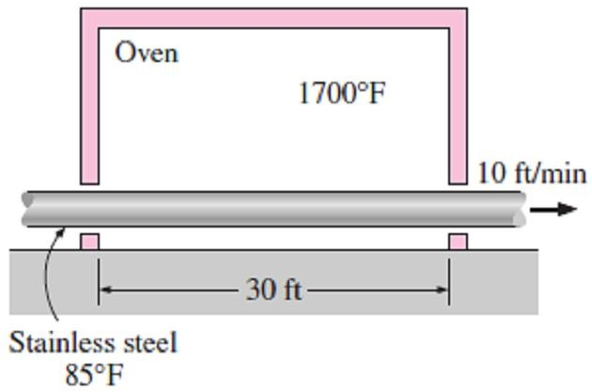
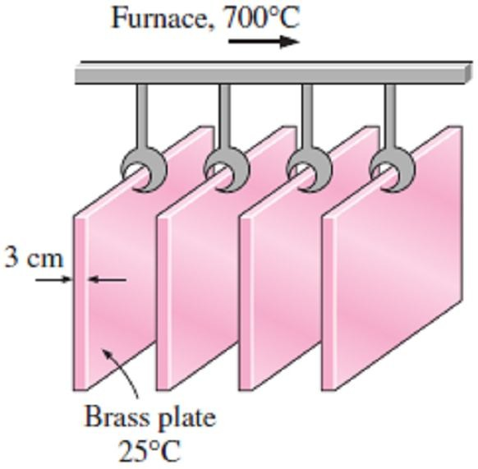
Chapter Four
Transient Heat Conduction
4.11- A long 35cm-diameter cylindrical shaft made of stainless steel (k = 14.9 W/m ·C°, ρ = 7900 kg/m³, C_{p} = 477 J/kg ·C°, and α = 3.95×10⁻⁶ m²/s) comes out of an oven at a uniform temperature of 400C°. The shaft is then allowed to cool slowly in a chamber at 150C° with an average convection heat transfer coefficient of h
= 60 W/m² ·C°. Determine the temperature at the center of the shaft 20 min after the start of the cooling process. Also, determine the heat transfer per unit length of the shaft during this time period. Answers: 390C°, 16,015 kJ/m
Prob.(4.7)
4.8- An electronic device dissipating 30 W has a mass of 20g, a specific heat of 850 J/kg ·C°, and a surface area of 5cm². The device is lightly used, and it is on for 5min and then off for several hours, during which it cools to the ambient temperature of 25C°. Taking the heat transfer coefficient to be 12 W/m²·C°, determine the temperature of the device at the end of the 5-min operating period. What would your answer be if the device were attached to an aluminum heat sink having a mass of 200g and a surface area of 80cm²? Assume the device and the heat sink to be nearly isothermal.
Answers: 527.8C°, 69.5C°
4.12- Long cylindrical stainless steel rods (k =
7.74 Btu/h ·ft ·F° and α = 0.135 ft²/h) of 4in diameter are heat-treated by drawing them at a velocity of 10ft/min through a 30ft-long oven
maintained at 1700F°. The heat transfer
coefficient in the oven is 20 Btu/h ·ft² ·F°. If the rods enter the oven at 85F°, determine their centerline temperature when they leave.
Answers: 228F°
4.9- An ordinary egg can be approximated as a 5.5cm diameter sphere whose properties are roughly k = 0.6 W/m ·C° and α = 0.14×10⁻⁶ m²/s. The egg is initially at a uniform temperature of 8C° and is dropped into boiling water at 97C°. Taking the convection heat transfer coefficient to be h = 1400 W/m²·C°, determine how long it will take for the center of the egg to reach 70C°.
Answer: 17.8 min
Prob.(4.12)
4.10- In a production facility, 3cm-thick large brass plates (k = 110 W/m ·C°, ρ = 8530 kg/m³, C_{p} = 380 J/kg ·C°, and α = 33.9 × 10⁻⁶ m²/s) that are initially at a uniform temperature of 25C° are heated by passing them through an oven maintained at 700C°. The plates remain in the oven for a period of 10min. Taking the convection heat transfer coefficient to be h = 80 W/m² ·C°, determine the surface temperature of the plates when they come out of the oven.
Answer: 445C°
4.13- A long cylindrical wood log (k = 0.17 W/m
C° and α =1.28×10⁻⁷ m²/s) is 10cm in diameter and is initially at a uniform temperature of 10C°. It is exposed to hot gases at 500C° in a fireplace with a heat transfer coefficient of 13.6 W/m² ·C° on the surface. If the ignition temperature of the wood is 420C°, determine how long it will be before the log ignites. Answer: 81.7 min
4.14- To determine the thermal conductivity of a hot dog piece that is 12.5cm long and 2.2cm in diameter, a thermocouple was inserted into the
midpoint of the hot dog and another thermocouple just under the skin, and we waited
until both thermocouples read 20C°, which is the ambient temperature. After that the hot dog was dropped into boiling water of temperature 94C°, and observed the changes in both temperatures. Exactly 2min after the hot dog was dropped into the boiling water, the center and the surface temperatures were recorded to be 59C° and 88C°, respectively. The density of hot dog can be
Prob.(4.10)

Slide 18
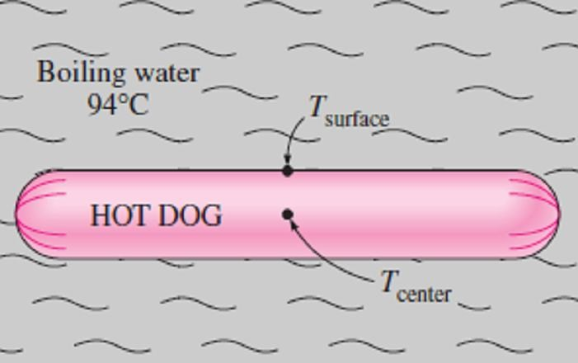
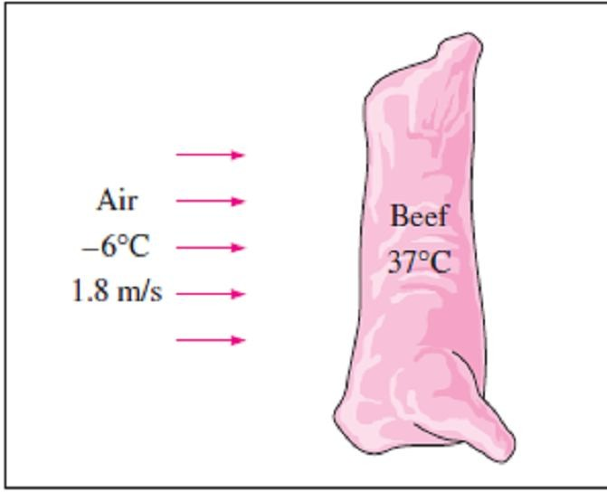
Chapter Four
Transient Heat Conduction
taken to be 980 kg/m³, while the specific heat of a hot dog can be taken to be 3900 J/kg·C°. Using transient temperature charts, determine (a) the thermal diffusivity of the hot dog, (b) the thermal conductivity of the hot dog, and (c) the convection heat transfer coefficient.
Answers: (a) 2.02×10⁻⁷ m²/s, (b) 0.771 W/m ·C°, (c) 467 W/m² · C°
4.18- A 65kg beef carcass (k = 0.47 W/m ·C° and α = 0.13×10⁻⁶ m²/s) initially at a uniform temperature of 37C° is to be cooled by refrigerated air at -6C° flowing at a velocity of 1.8m/s. The average heat transfer coefficient between the carcass and the air is 22 W/m² ·C°. Treating the carcass as a cylinder of diameter 24cm and height 1.4m and disregarding heat transfer from the base and top surfaces, determine how long it will take for the center temperature of the carcass to drop to 4C°. Also, determine if any part of the carcass will freeze during this process.
Answer: 14.0 h
Prob.(4.14)
4.15- Using the data and the answers given in Prob.(4.14), determine the center and the surface temperatures of the hot dog 4min after the start of the cooking. Also determine the amount of heat transferred to the hot dog.
Answers: 73.8 C°, 89.6 C°, 11,409 kJ
Prob.(4.18)
4.16- A person puts a few apples into the freezer at -15C° to cool them quickly for guests who are about to arrive. Initially, the apples are at a uniform temperature of 20C°, and the heat transfer coefficient on the surfaces is 8 W/m² ·C°. Treating the apples as 9cm-diameter spheres and taking their properties to be ρ = 840 kg/m³, C_{p} =
3.81 kJ/kg ·C°, k = 0.418 W/m ·C°, and α = 1.3×10⁻⁷ m²/s, determine the center and surface temperatures of the apples after 1hour. Also, determine the amount of heat transfer from each apple. Answers: 11.2 C°, 2.7 C°, 17.2 kJ
4.17- A 6mm thick stainless steel plate (ρ = 7800 kg/m³, C_{p} = 460 J/kg ·C°, k = 55 W/m ·C°) is used to form the nose section of a missile. It is held initially at a uniform temperature of 30C°. When the missile enters the denser layers of thr atmosphere at a very high velocity, the effective temperature of air surrounding the nose region attains the value 2150C°, the surface convection heat transfer coefficient is estimated as 3395 W/m² ·C°. If the maximum metal temperature is not exceed 1100C°, determine the maximum permissible time in these surroundings.
Answer: 2.58 sec
4.19- An 8cm-diameter potato (ρ = 1100 kg/m³, C_{p} = 3900 J/kg ·C°, k = 0.6 W/m ·C°, and α = 1.4
×10⁻⁷ m²/s) that is initially at a uniform
temperature of 25C° is baked in an oven at 170C° until a temperature sensor inserted to the center of the potato indicates a reading of 70C°. The potato is then taken out of the oven and wrapped in thick towels so that almost no heat is lost from the baked potato. Assuming the heat transfer coefficient in the oven to be 25 W/m² ·C°, find
how long the potato is baked in the oven and
the final equilibrium temperature of the potato after it is wrapped. Answers: 38.7 min, 101C°

